Slide 1


Cooking made easy

Slide 2


What is RE-FRESH?

Slide 3


Goal
To change and Improve people lifestyle

Slide 4




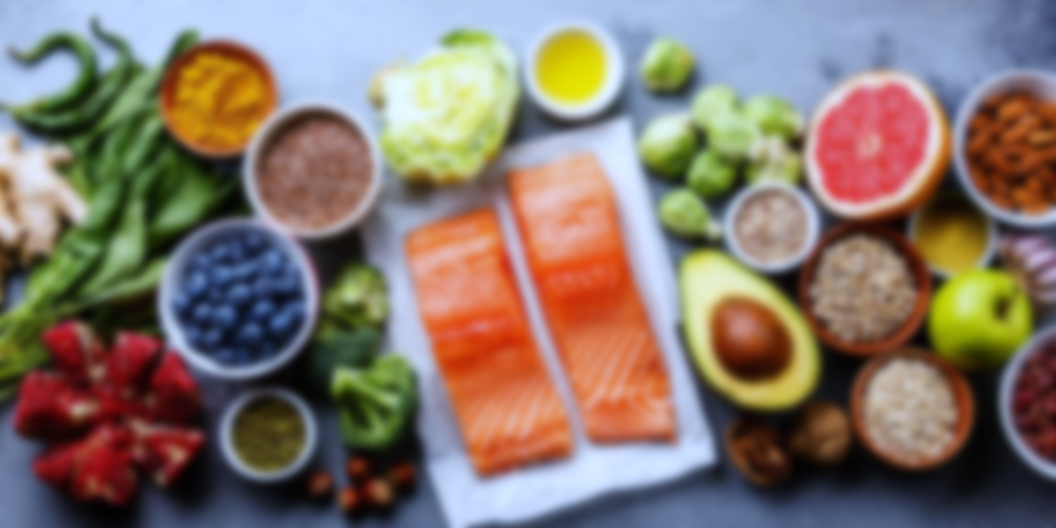

Vision and Mission
Buy from an authorized farmer company
To be a leading company in providing healthy and fresh food
The ingredient that are sends to our customer are in the best quality
Send recipes from our professional chefs that are easy to follow

Slide 5
Strengths and Weaknesses
The first one in Indonesia
Provide healthy and fresh ingredients with affordable price
Provide a lot of variety of menus
Limited only in Jakarta

Slide 6
Opportunities and Threats
Dominate the market share
Increasing market growth
Indonesian lifestyle
Customers may not prolong their subscription plan
Unstable market price

Slide 7






Market Strategy
Target Audience

Slide 8

Estimated Growth

Slide 9

Budget
Budget

Slide 10
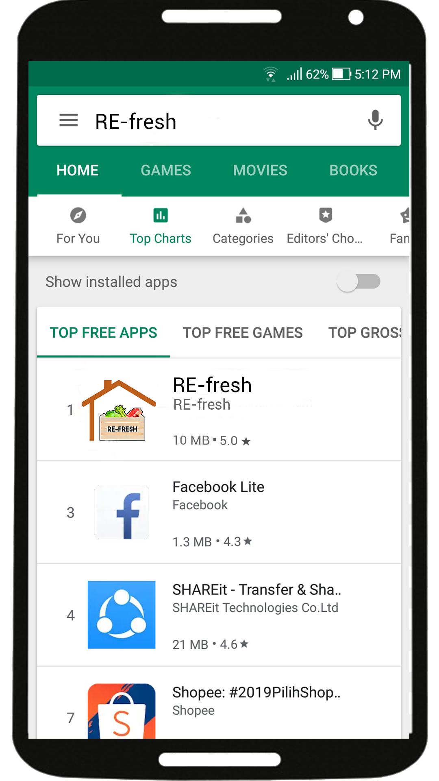
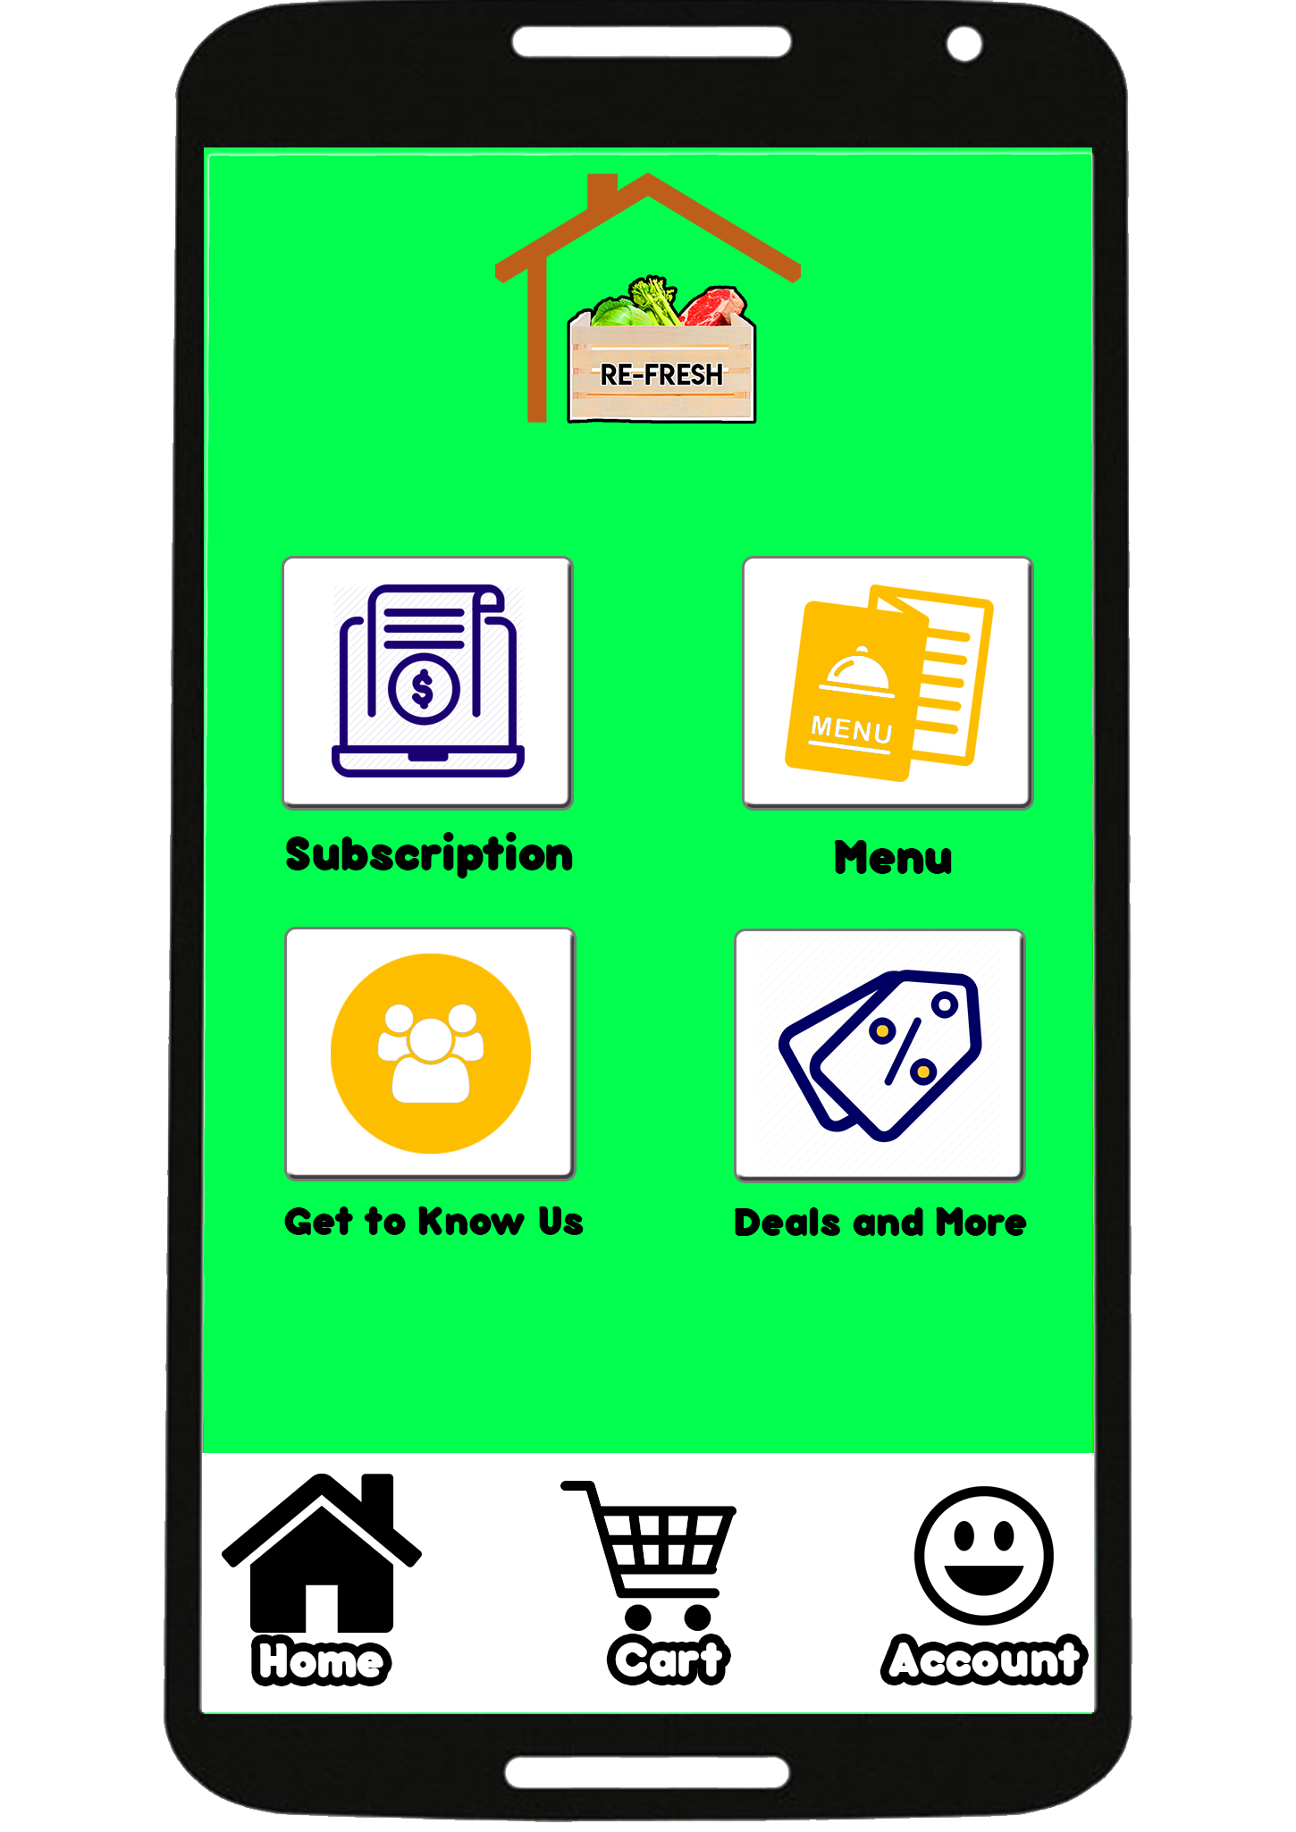
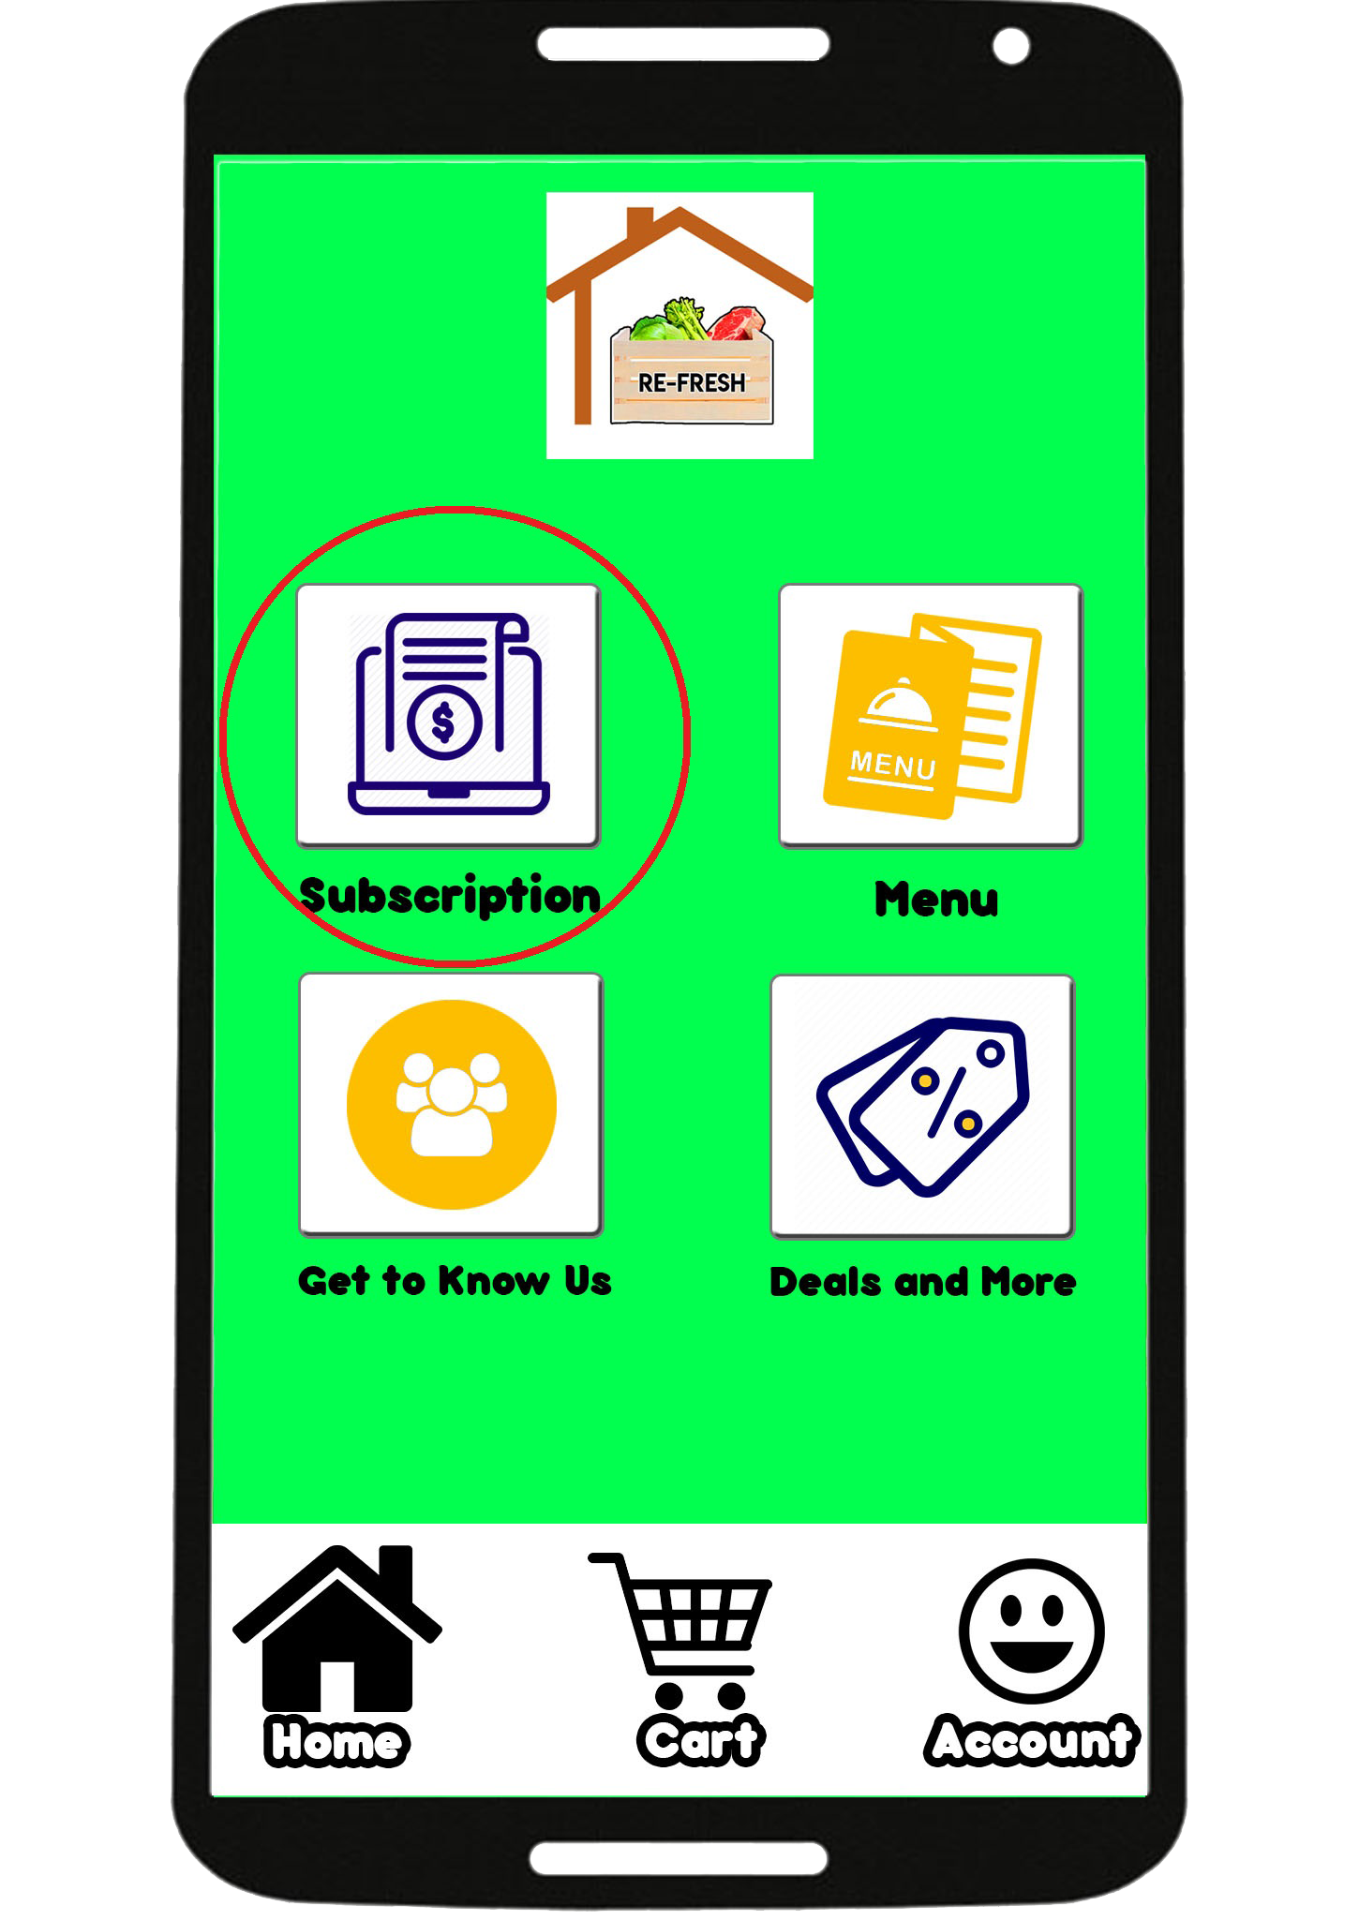
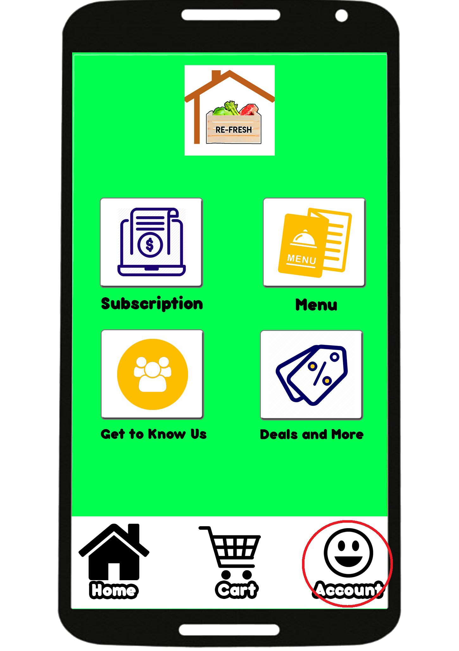
How To Order RE-FRESH

Slide 11
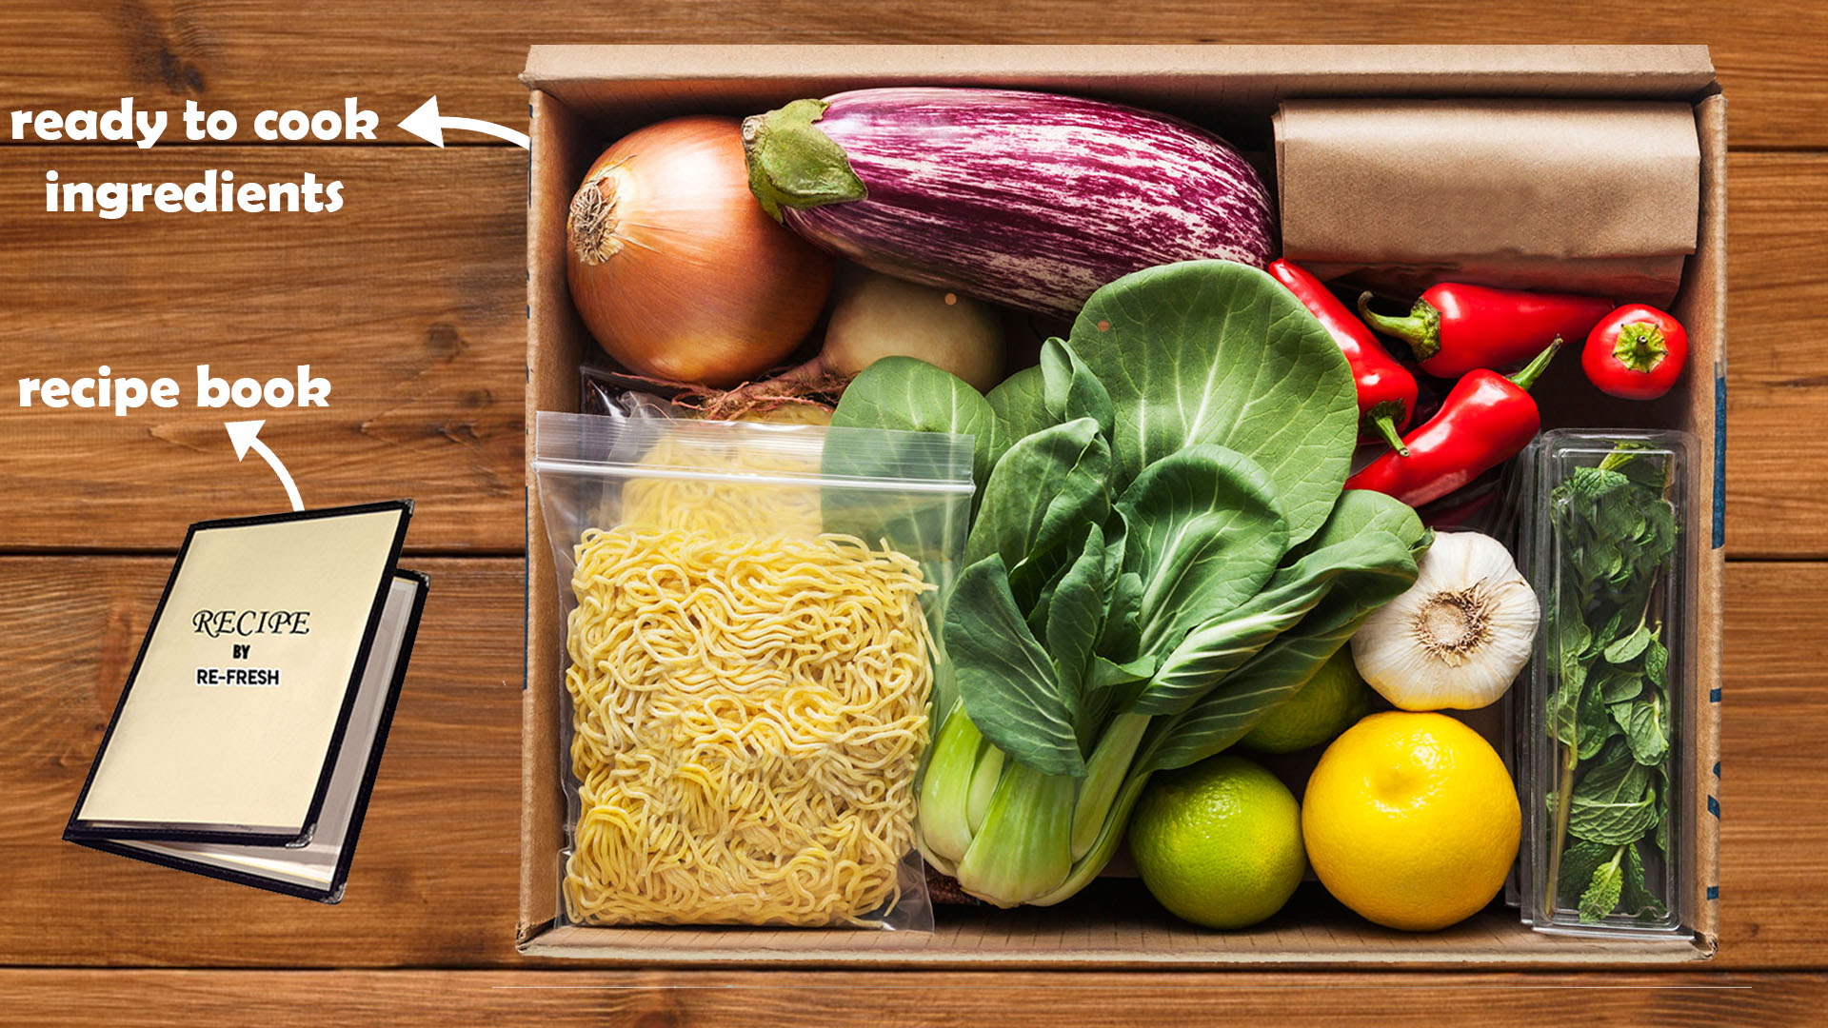
What the customers get

